Slide 1
ECE2021 Smart Building Project Proposal
----------------------------------------------------------------------------------------------------------------------------
Mini Smart House
Group Members:
Lê Quốc Định - 10221009
Phạm Nam Nhật - 10221036
Trần Hồng Vũ - 10221049

Slide 2
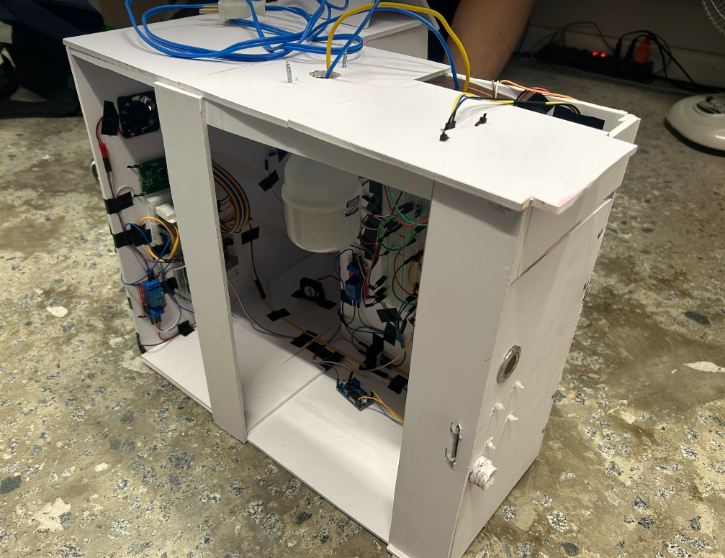
INDEX
1. Introduction
1.1. Background
1.2. Objectives
1.3. Requirements
2. Statement of Work
2.1. System Description
2.2. Design Approach
2.3. Timeline
3. Ethical Dimensions and Safety Aspects
3.1. Privacy Concerns
3.2. Environment Enhancements

Slide 3
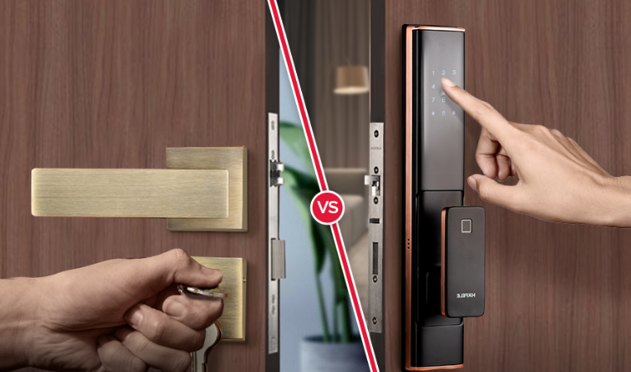
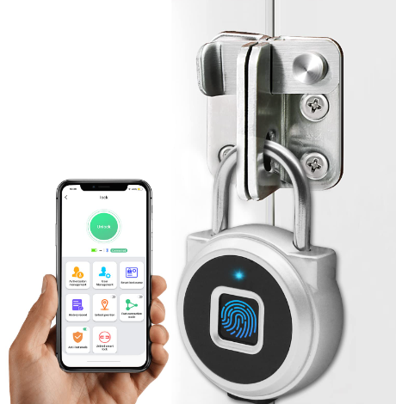
1. INtroduction
1.1. Background
The idea of traditional locks and keys has changed significantly in an era marked by fast
technological developments.
Smart locks, often known as electronic locks, are a
cutting-edge way to improve convenience and security in residential settings.
Without the need of actual keys, these electrical locks use electronic identification techniques to grant entry to the premises.

Slide 4
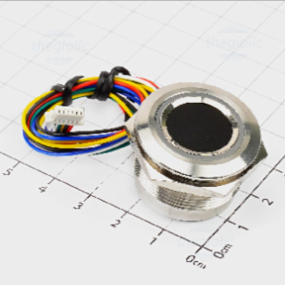
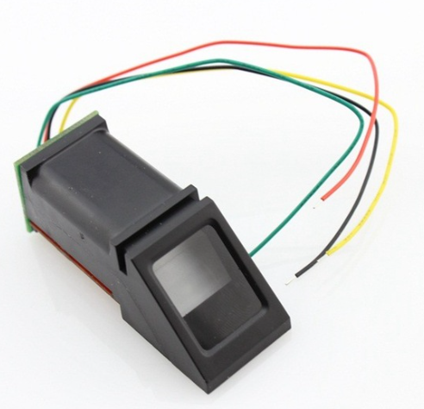
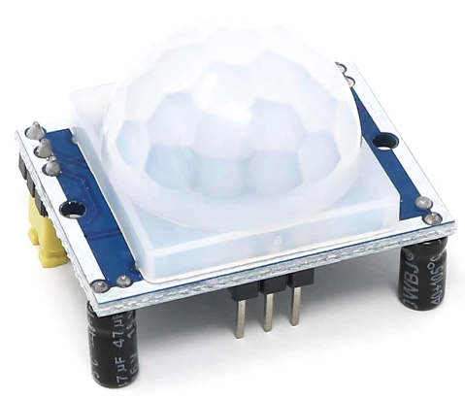
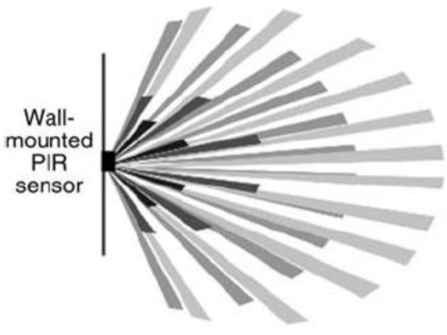
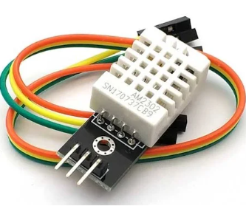
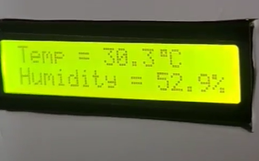
1. Introduction
1.2. Objectives
Use a capacitive fingerprint sensor instead of optical for security purposes
Use a PIR sensor for lighting hallway
Use a humidity and temperature sensor for controlling inside air purposes

Slide 5

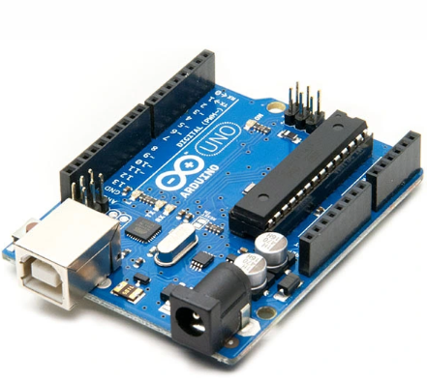
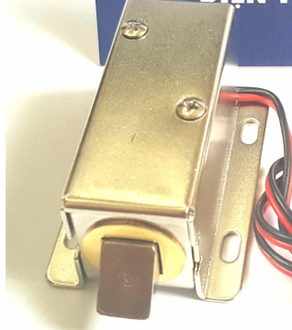
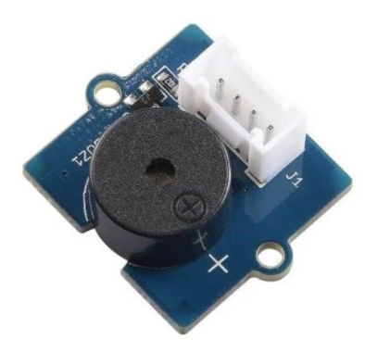

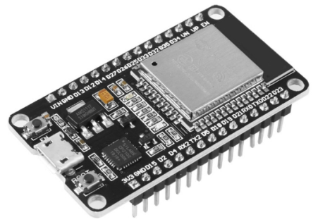
1. Introduction
1.3. Requirements
Arduino Microcontroller UNO R3 V3 and its IDE
Capacitive Fingerprint Sensor, electric lock and buzzer
PIR Sensor, ESP32 and Blynk App

Slide 6
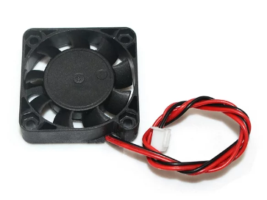
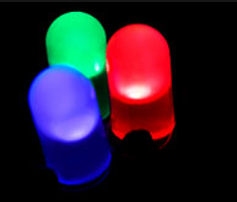
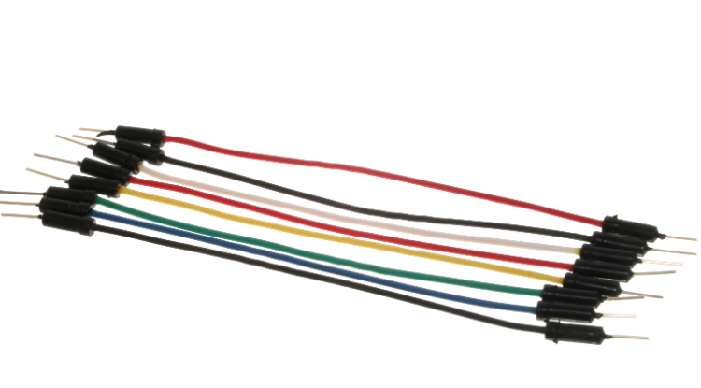
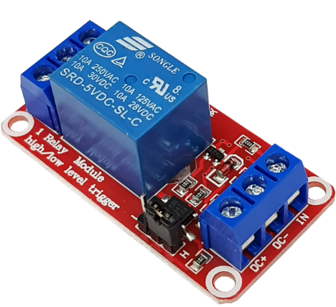
1. introduction
1.3. Requirements
DHT22 Humidity and Temperature Sensor, LCD
Fan and LEDs
Other required items like: wires, relay modules,…

Slide 7
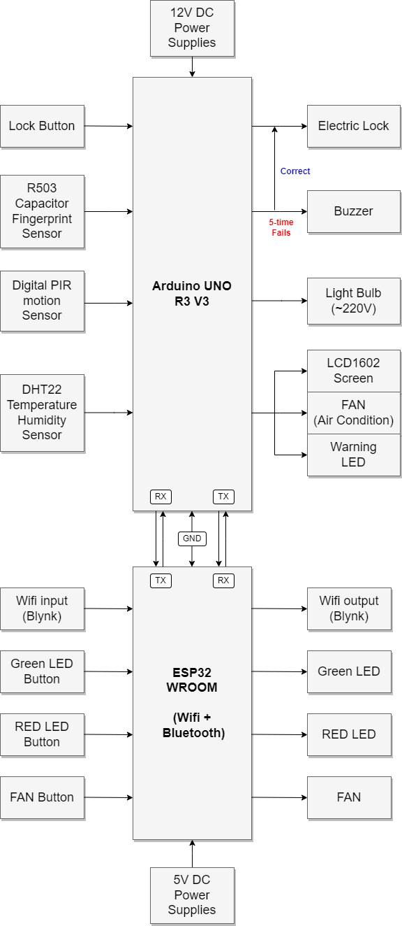
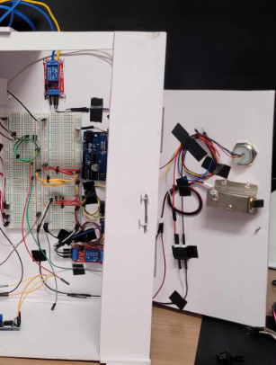
2. Statement of work
2.1. System Description
Our project will have an Arduino UNO on the backside of the door attached to a board of
an electric lock, a small button, a relay module, and an ESP32 module.

Slide 8
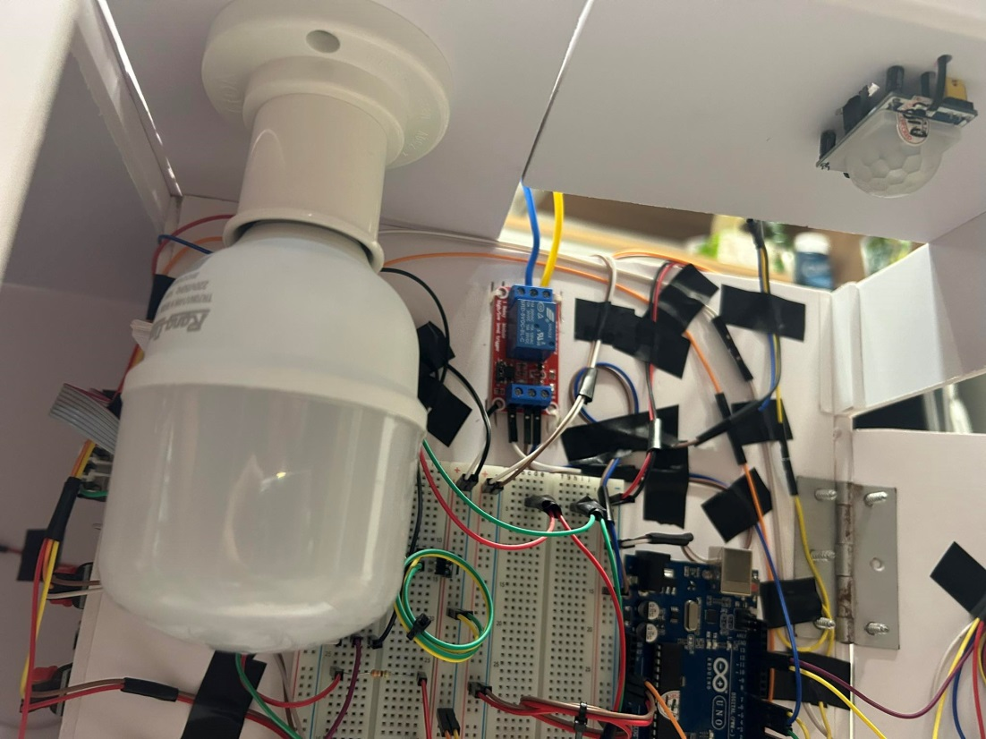
2. Statement of work
2.1. System Description
These will be attached to a PIR sensor and LEDs on the ceiling.

Slide 9
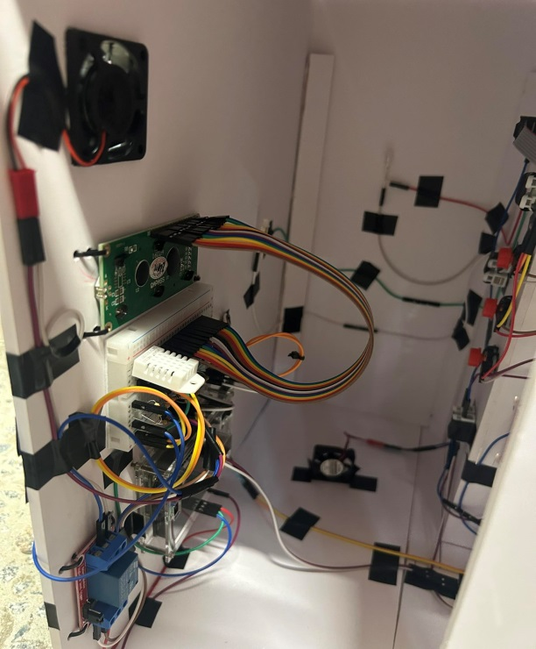
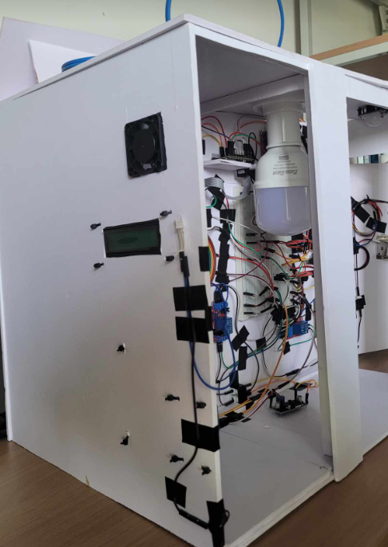
2. Statement of work
2.1. System Description
Another Arduino UNO will be used for connecting to a humidity sensor which will detect room temperature and be shown on a LCD screen, then adjust the room temperature by turning a fan on a wall.

Slide 10
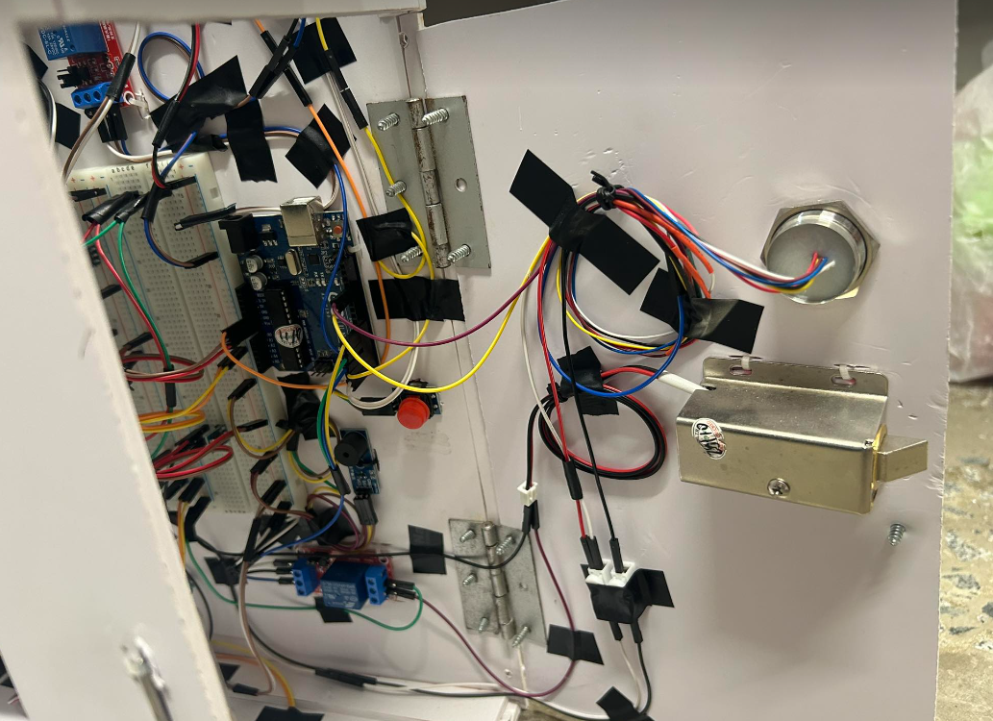
2. Statement of work
2.1. System Description
The frontside of the door will have a fingerprint authenticator and a buzzer, which will be wired through the door.

Slide 11
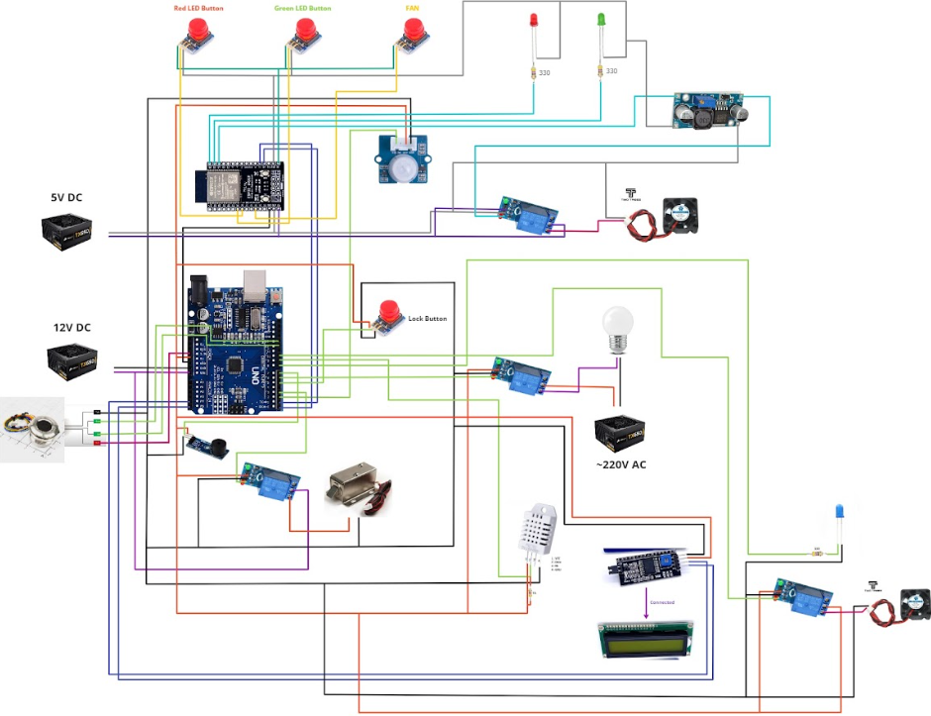
2. Statement of Work
2.2. Design Approach
Circuit Design

Slide 12
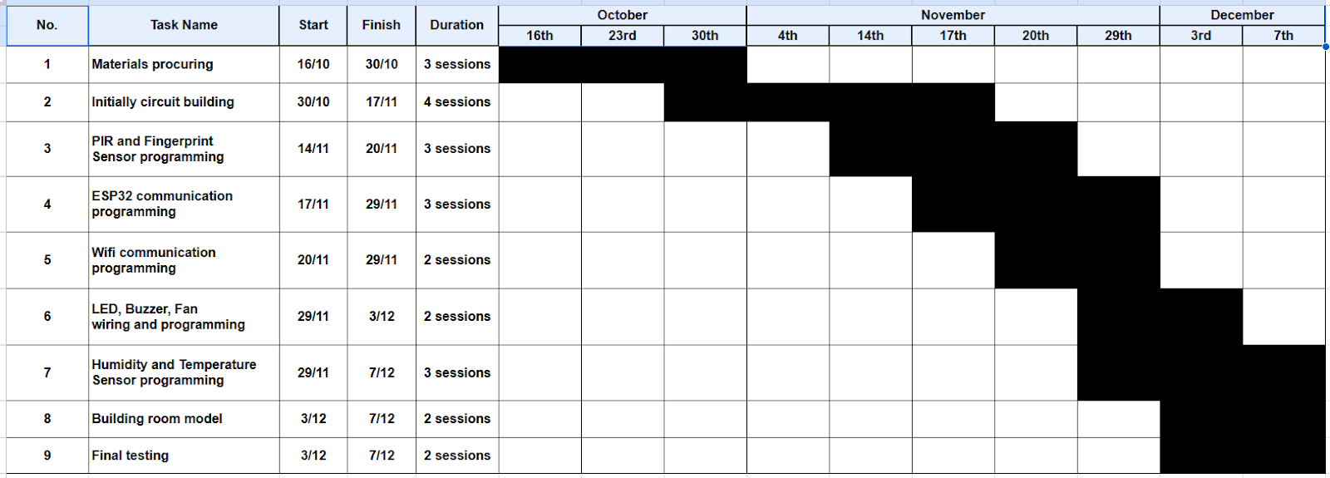
2. Statement of work
2.3. Timeline
The 1st three weeks were for procuring materials and checking datasheets and libraries for programming

Slide 13
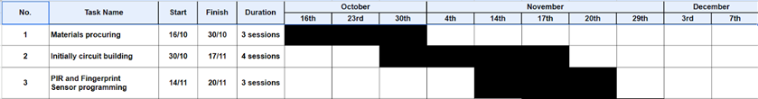
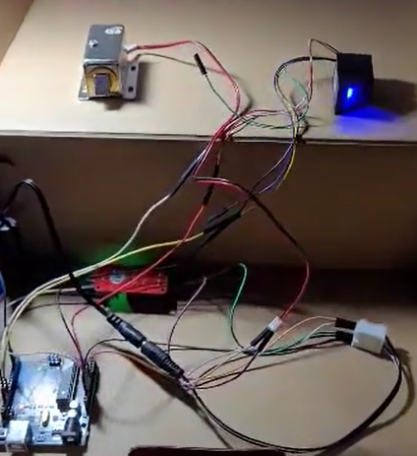
2. Statement of work
2.3. Timeline
For the next 4 weeks, we initially built a circuit contain PIR sensor, LEDs, Fingerprint Sensor, Solenoid Electric Lock, and buzzer, which were the foundation of our coding and pin wiring.

Slide 14
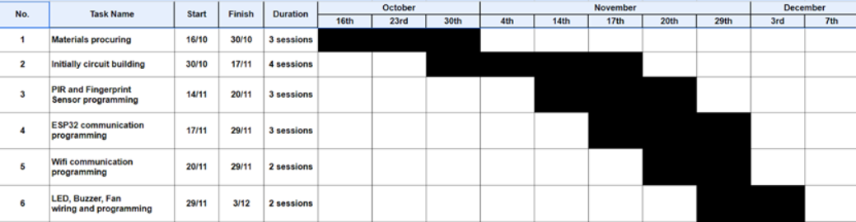
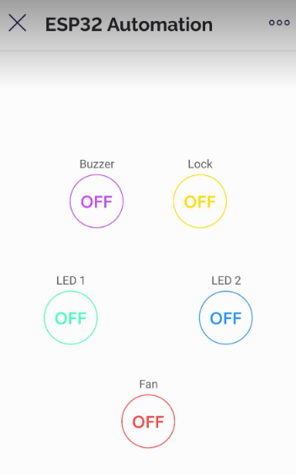
2. Statement of work
2.3. Timeline
For the next 3 weeks, we tried to build and maintain the connection between ESP32 and Blynk App on phone through Wi-Fi, also some shortcut activating buttons.

Slide 15
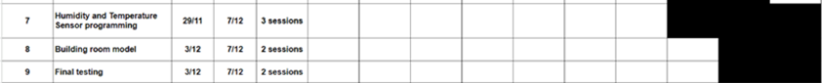
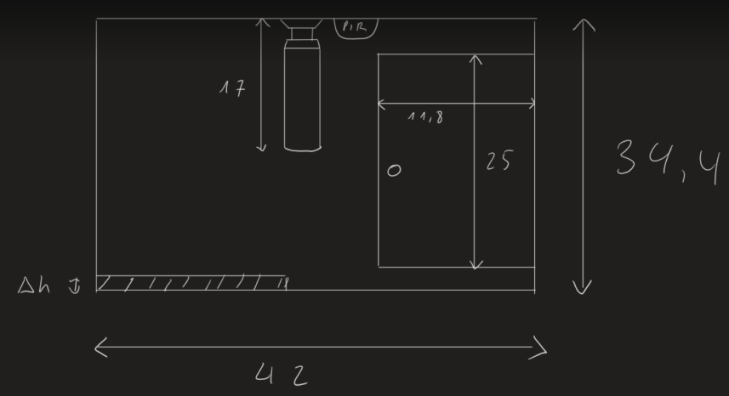
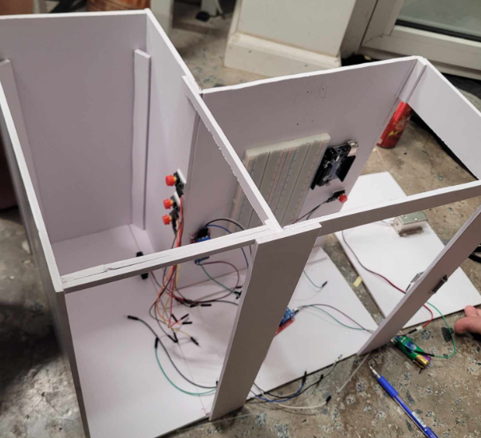
2. Statement of work
2.3. Timeline
Since we already built the foundation, the rest of code and wiring were easily combined, which were of humidity and temperature sensor and displaying status on the LCD. While wiring the rest, we also sketched and built a room model from Formex.

Slide 16
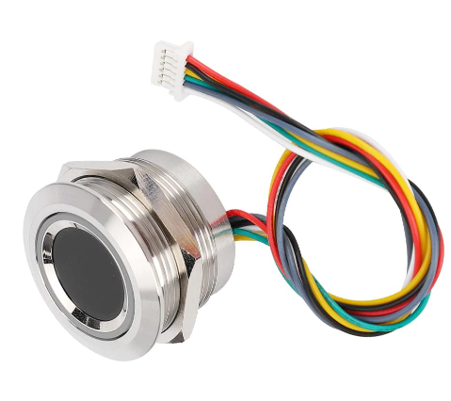

3. Ethical dimensions and safety aspects
3.1. Privacy Concerns
The fingerprint sensor we used can store up to 200 different fingerprints. If people interact with wrong fingerprints 3 times in 1 minute, this will activate the buzzer for a while.
The collection and storage of data for fingerprint authentication raise critical privacy concerns. Users must entrust their most unique and personal identifiers to these systems, invoking questions about data security and the potential for misuse.

Slide 17
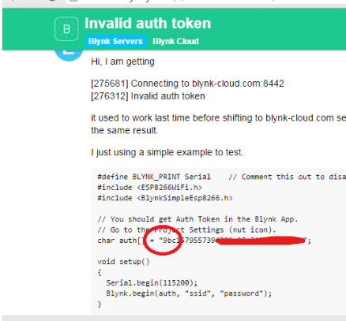
3. Ethical dimensions and safety aspects
3.1. Privacy Concerns
Try not to let strangers or even your family who aren’t used to app communication know about Auth Token of your Blynk. This can lead to many annoying situations.

Slide 18
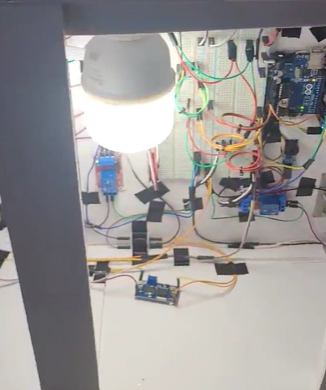
3. Ethical dimensions and safety aspects
3.2. Environment Enhancements
The integration of motion-sensor-activated lighting contributes not only to security but also to safety within the home. Illuminated pathways reduce the risk of accidents and provide a sense of security during the dark hours

Slide 19
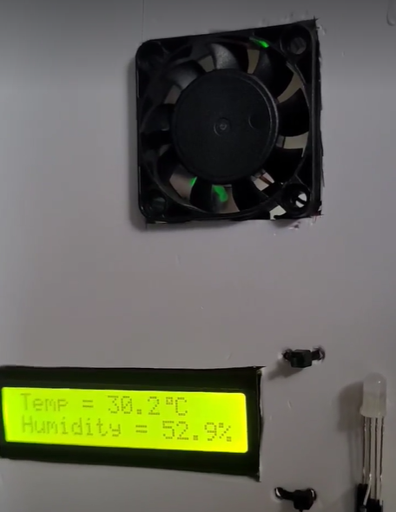
3. Ethical dimensions and safety aspects
3.2. Environment Enhancements
With the humidity and temperature sensor, it keeps the temperature in appropriate scales to provide a flexible and comfortable environment by activating the fan.
Temperature > 35°C | Fan => On
Humidity < 20%

Slide 20

THE END
THANKS FOR LISTENING!

